Slide 1

Chapter 5 Formatting

Slide 2
How do you acknowledge one code as well-formatted ?
README instructions
Lines of code in each file
Indentations and spaces
Packages and modules

Slide 3
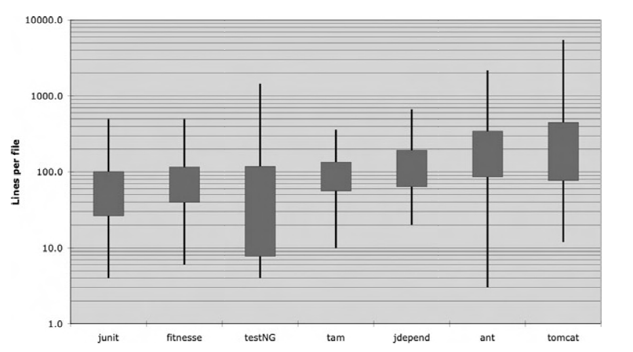
Vertical Formatting
How big should a source file be?
Notes:
Small files are usually easier to understand than large files are.

Slide 4
The Newspaper Metaphor
You read it vertically
At the top There are Headers
At the bottom there are details
Notes:
Show them Logikan library

Slide 5
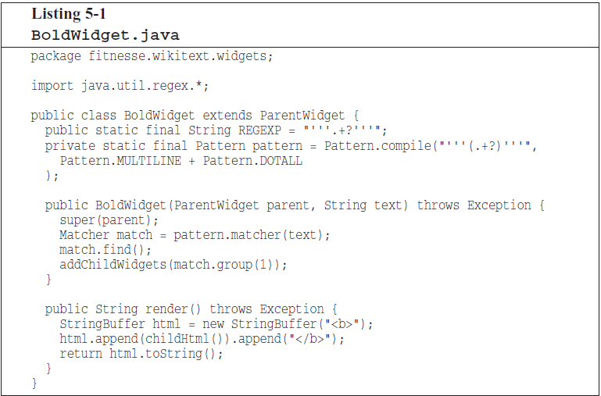
Vertical Openness Between Concepts
Notes:
Use blank lines to separate different concepts in your code

Slide 6
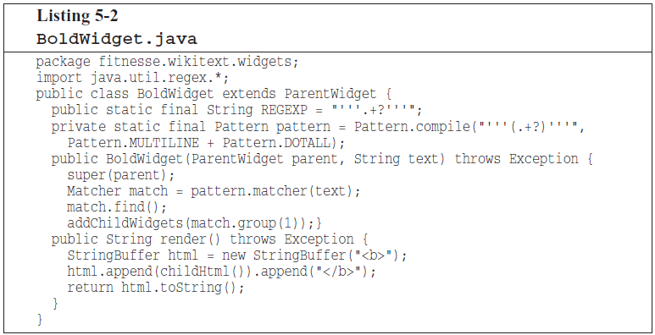
Same code without vertical openness

Slide 7
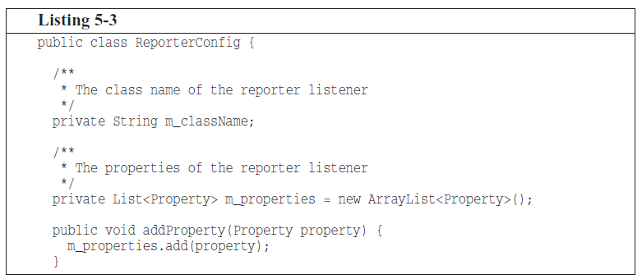
Vertical density
Notes:
Notice how the useless comments in Listing 5-3 break the close association of the two instance variables.

Slide 8
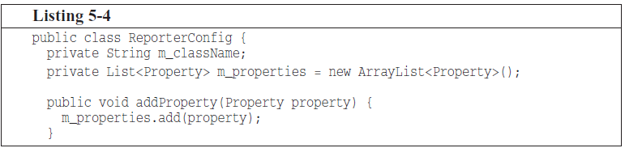
Vertical density

Slide 9
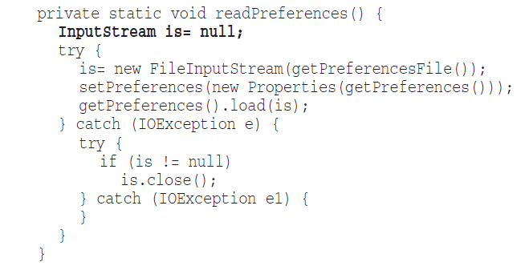
Vertical distance Variable Declarations
Notes:
Variables should be declared as close to their usage as possible

Slide 10
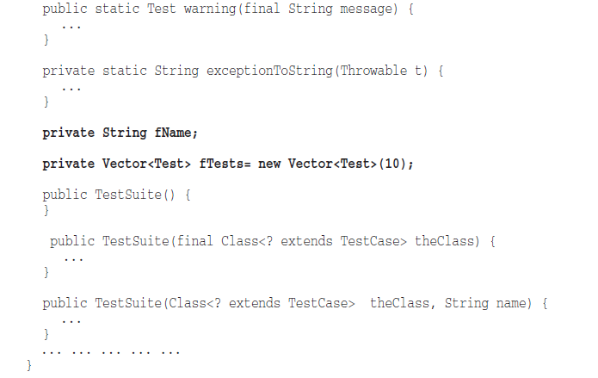
Vertical distance Instance variables
Notes:
Define them at the top of class, (or in a place well known for everybody)

Slide 11
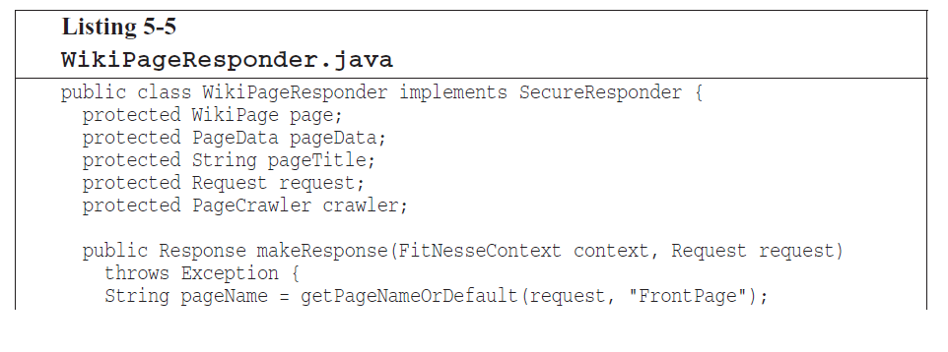
Vertical distance Dependent functions
Notes:
If one function calls another, they should be vertically close,
and the caller should be above the callee

Slide 12
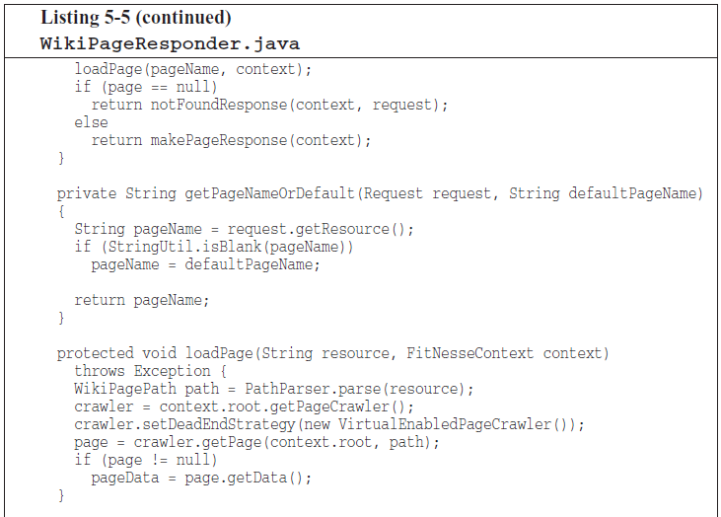

Slide 13
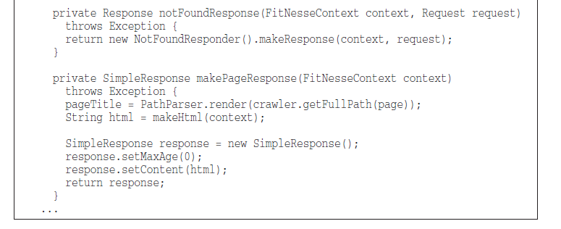

Slide 14
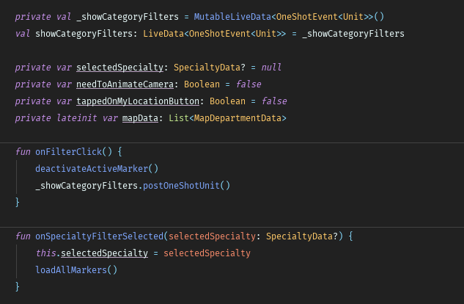
Vertical distance Conceptual Affinity
Notes:
Concepts that are related to each other place them together.

Slide 15
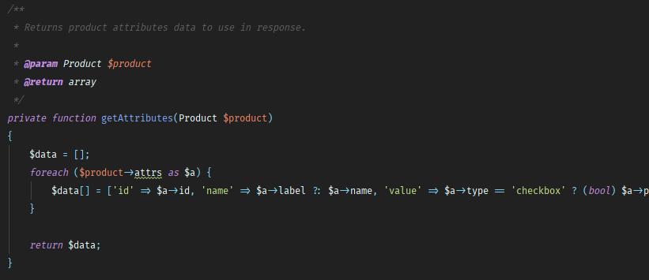
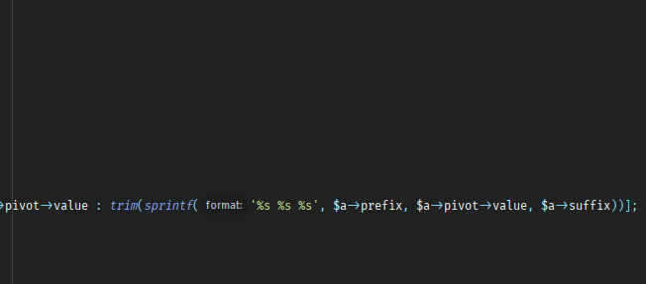
Horizontal Formatting

Slide 16
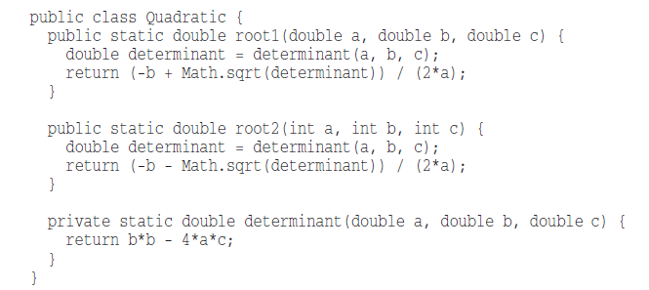
Horizontal Openness and Density
Notes:
accentuate the precedence of operators

Slide 17
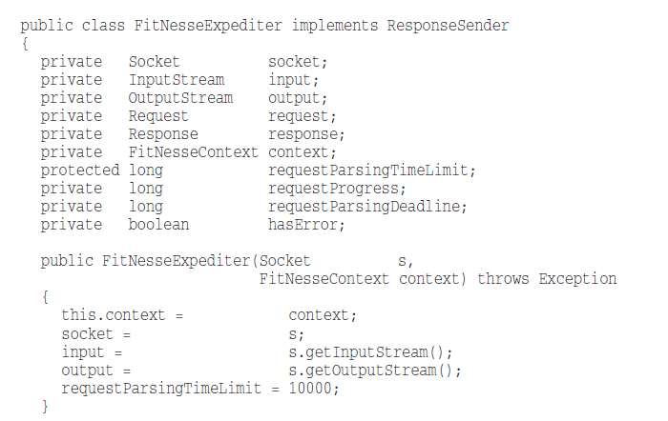
Horizontal alignment
Notes:
Don’t do this anymore

Slide 18
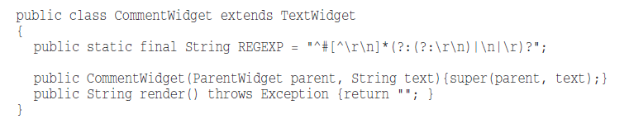
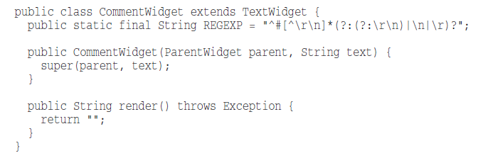
Indentation

Slide 19

Dummy scopes
Notes:
In one line statements like while with captured resource loop
use indentation and braces to make it more visible
Or put semicolon in a separate line of its own with indentation

Slide 20
Team Rules
Agree upon team rules and follow coding styles used in your organization

Slide 21
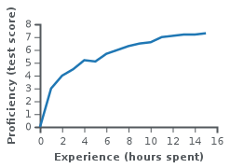
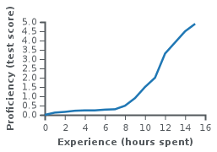
Vocabulary: Learning curve
Relationship between Proficiency and Amount of time you spend to learn something To do a task as Done.
Notes:
Use learning curve theory to:
Choose between tools to work with.
Estimate your work on R&D tasks

Slide 22
Tool: Font ligature
Programmers use a lot of symbols, often encoded with several characters. For the human brain, sequences like ->, => or := are single logical tokens, even if they take two or three characters on the screen.
https://github.com/tonsky/FiraCode

Slide 23
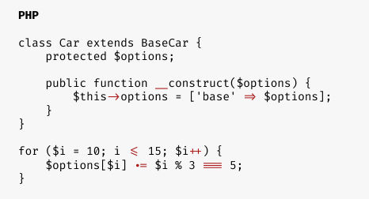
Tool: Font ligature
https://github.com/tonsky/FiraCode

Slide 24
Thank You!

